Slide 1

Data Programming (BDAT 1004 02 – Group 4) Final Project
TEAM MEMBERS
ABHISHEK (200467064) CAROLYN KNIGHT (200289345)
JAMES MURRAY (200236211) SWETA PATEL (200468627)

Slide 2

INTRODUCTION
Amphibians Data
Established in 1964, The International Union for Conservation of Nature’s (IUCN) Red List of Threatened Species has evolved to become the world’s most comprehensive information source on the global conservation status of animal, fungi and plant species.
The IUCN Red List is a critical indicator of the health of the world’s biodiversity. Far more than a list of species and their status, it is a powerful tool to inform and catalyze action for biodiversity conservation and policy change, critical to protecting the natural resources we need to survive.
This Data contains information about Amphibian species, which are included in the IUCN’S Red List of Threatened Species. Specifically, the amphibians in this data set are specific to Canada and the USA. Amphibians are small vertebrates that need water, or a moist environment, to survive. The species in this group include frogs, salamanders etc. All can breathe and absorb water through their very thin skin.
Reference:
https://amphibiaweb.org/amphibian/amph_index.html

Slide 3
Business Questions
Question 1. Under which IUCN Red List status categories do these species fall?
Are any species already extinct or are on the verge of extinction?
Question 3. Which family of amphibians comprises the maximum number of species on the IUCN Red List?
Question 2. Suppose the WildLife Department has a budget of $100 million to save the near threatened and vulnerable amphibians from extinction. How should the budget be split to ensure there is enough funds to support all amphibians?

Slide 4
Dataset Description
Attributes:
This Dataset contains 174 records/rows and 5 variables/columns.
It includes following Columns such as:
Scientific Names : Specie’s Scientific Names
IUCN Red List Status : 8 different categories under IUCN’s List Status
Vernacular Name : A common name of a taxon or organism
Family : Different families of amphibians
Order: The order is a taxonomic rank used in the classification of organisms

Slide 5
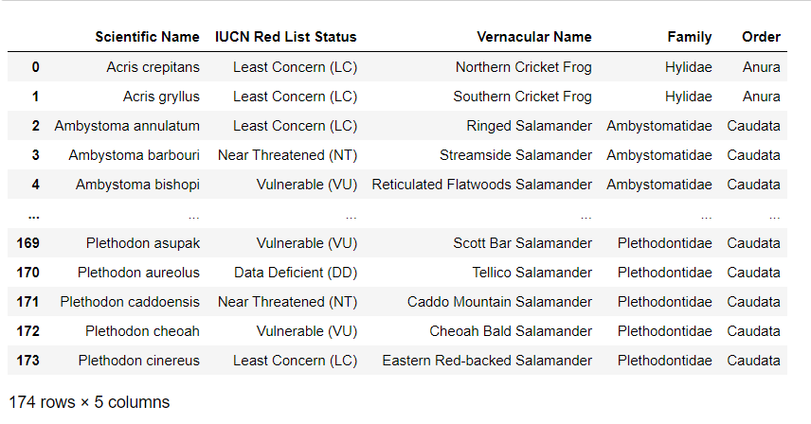
Dataset

Slide 6
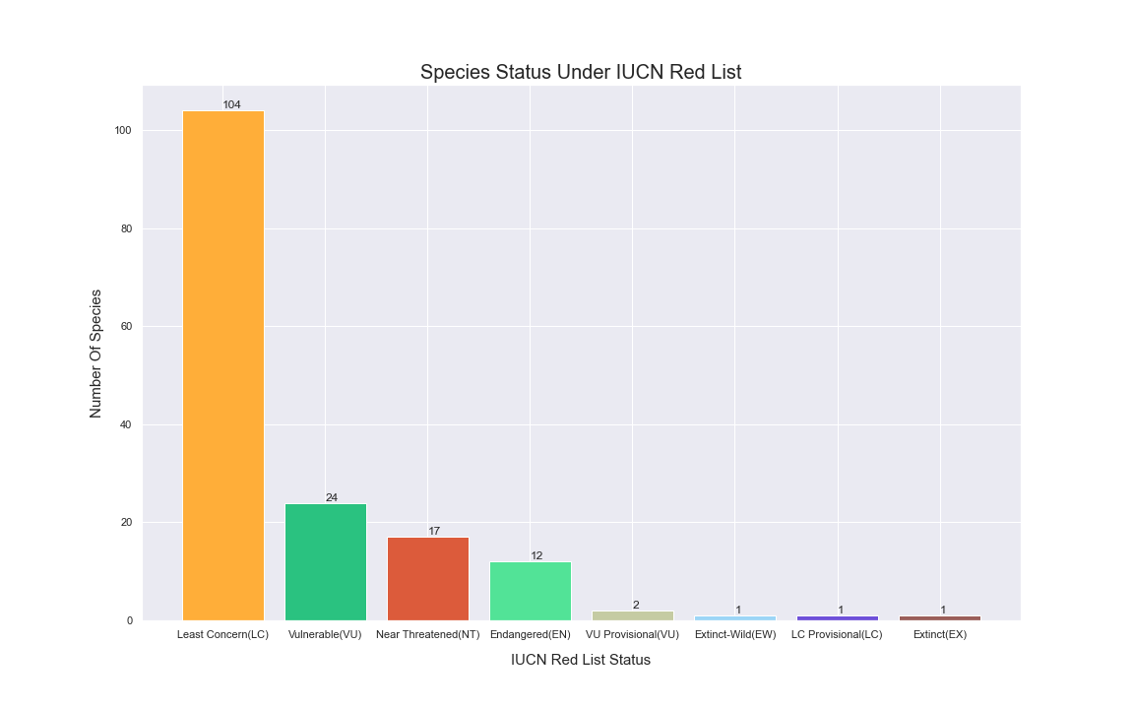
Bar Graph (Matplotlib)

Slide 7
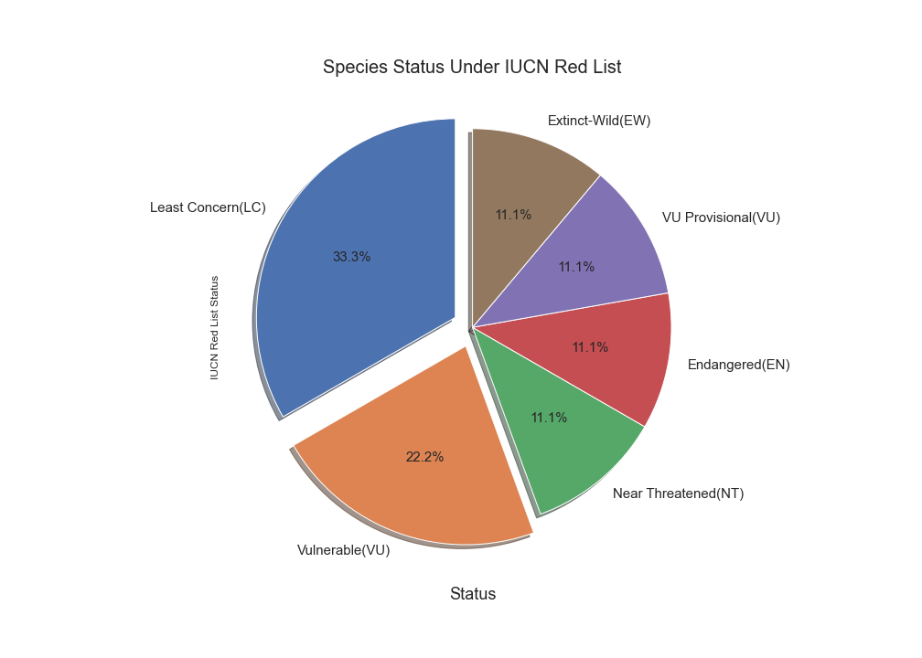
Pie Chart (Matplotlib)

Slide 8
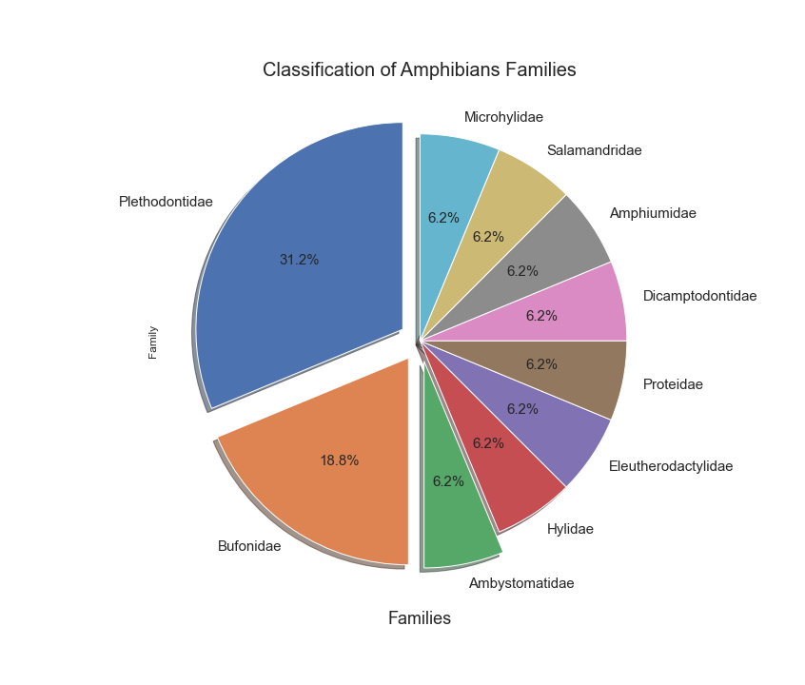
Pie Chart (Matplotlib)

Slide 9

Analysis Results
From the bar chart and IUCN Red List pie chart, it’s clear that majority of the amphibian species comes under the Least Concern status i.e. 104 species.
But it can’t be overlooked that 55 amphibian species are already endangered, vulnerable or near threatened.
There is already one species, Catahoula Salamander (Plethodon Ainsworthi), that is already extinct. A second species, Wyoming Toad (Anaxyrus Baxteri), is extinct in the wild.
From the Amphibians Families pie chart, it’s evident that majority of amphibian species on the IUCN Red List belong to the Families Plethodontidae and Bufonidae. This accounts for a total of 55% of the total species on the list.

Slide 10
Conclusion
As per the analysis results, WildLife Department should spend $100 million to protect amphibians accordingly as:
$44M -> Endangered, Near Threatened and Extinct in the Wild species, as they are most exposed to the threat of extinction in the near future
$33M -> Least Concern species as they are greatest in number and to plan for better facilities.
$22M -> Vulnerable species

Slide 11

Thank You

